Slide 1

Netease Cloud Classroom
The analysis of
Group: The powerpuff girls
Member:Zhang Qinna,Yin Junhui,Shen Wangqi,
Zhou Chengmao,Liao Baige

Slide 2
01
The introduction
CONTENTS
02
The key elements
03
The summary

Slide 3
01
The introduction

Slide 4
The introduction
Netease
Open
Class
Netease Cloud Classroom
free
for public
charge
for vocational skills

Slide 5
02
The key elements

Slide 6
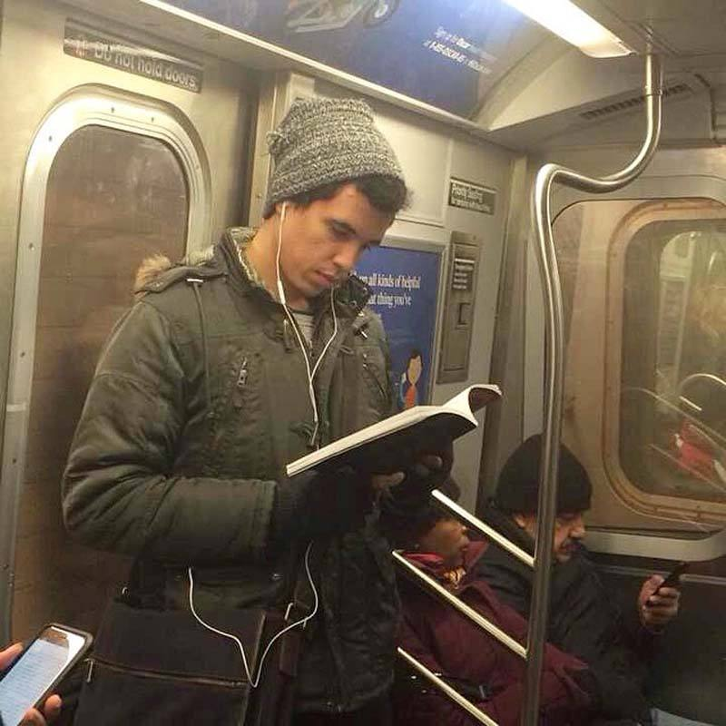
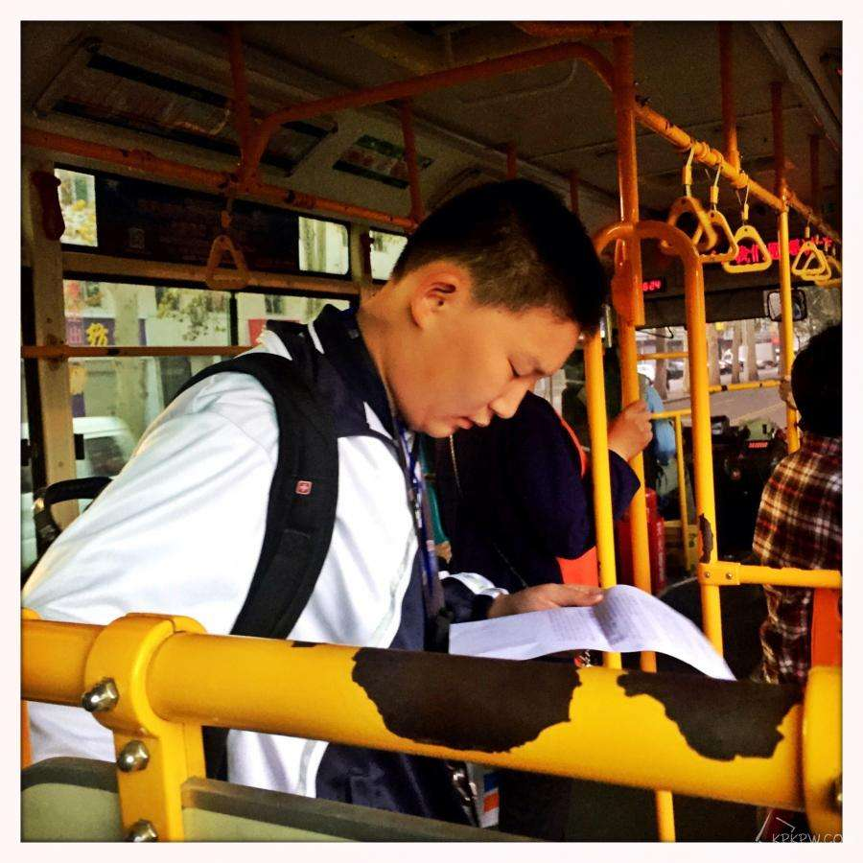
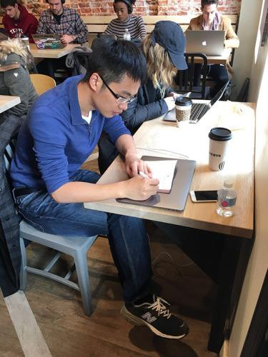
The key elements——Where to learn
On the subway On the bus
In the canteen In bed
anywhere you want……

Slide 7






The key elements——What to learn

Slide 8
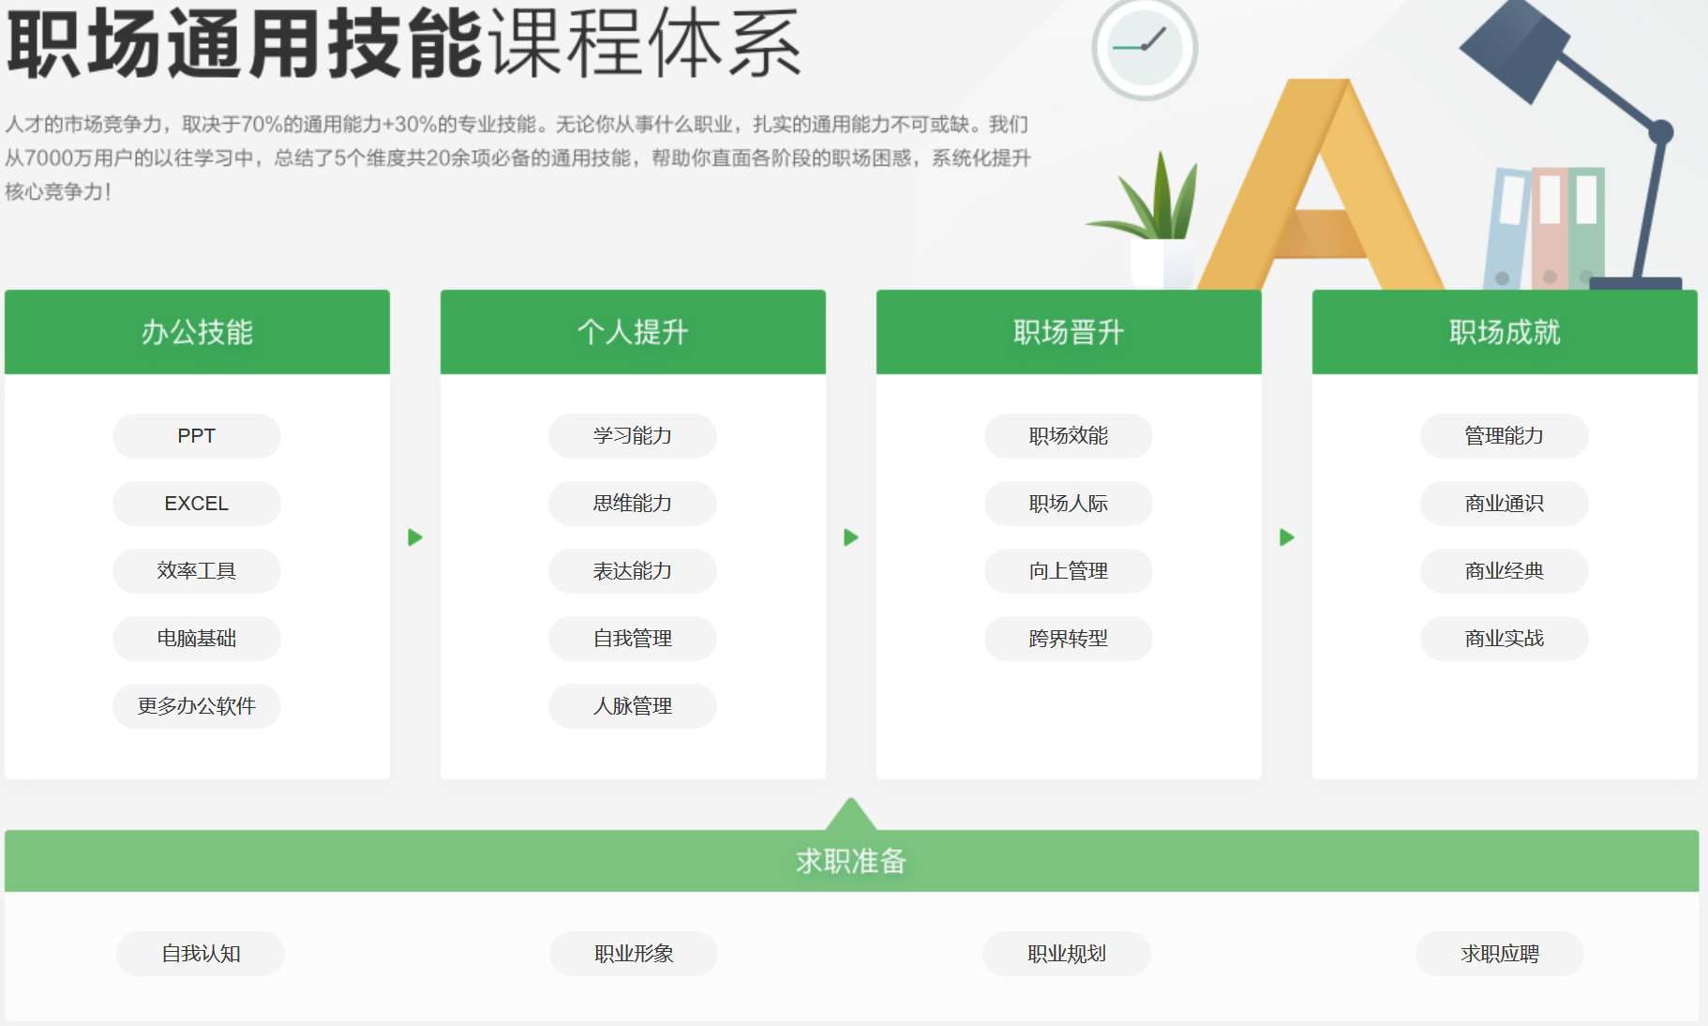
The key elements——What to learn
attitude
experience
knowledge
skills

Slide 9
The key elements——effect of learning
Improve learners' expectation of effort.
Improve learners' performance
Promote the understanding of knowledge by students.

Slide 10
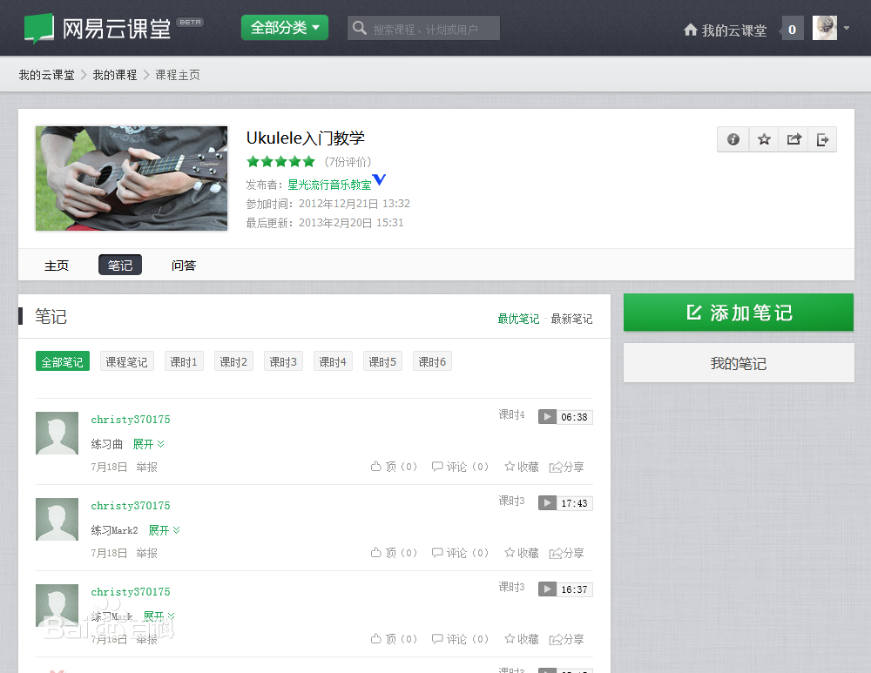
The key elements——How to learn
Note

Slide 11
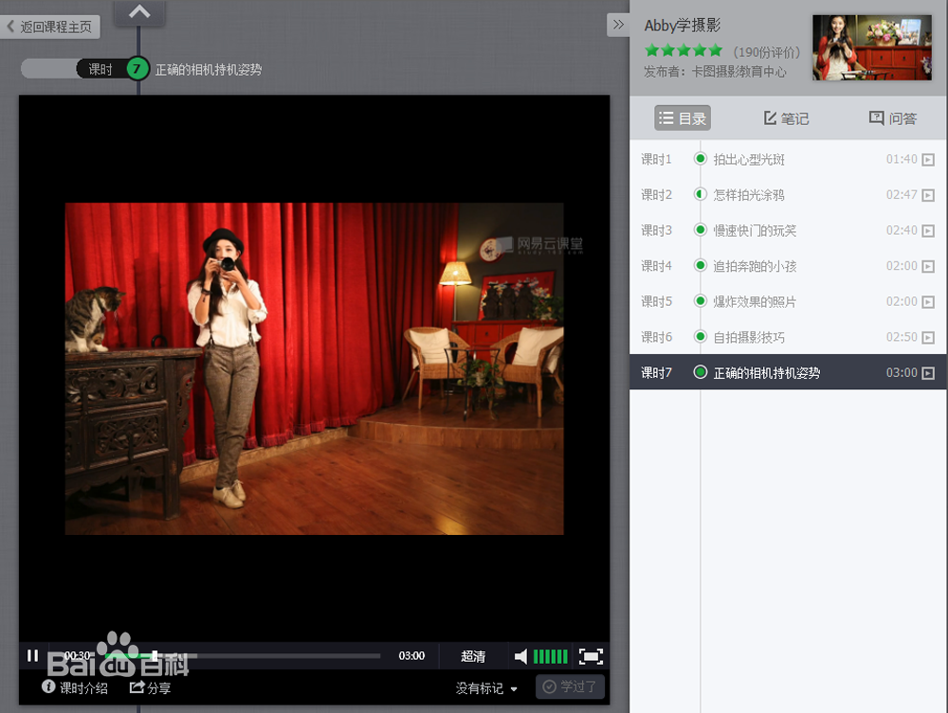
The key elements——How to learn
Progress Management and Learning Supervision

Slide 12
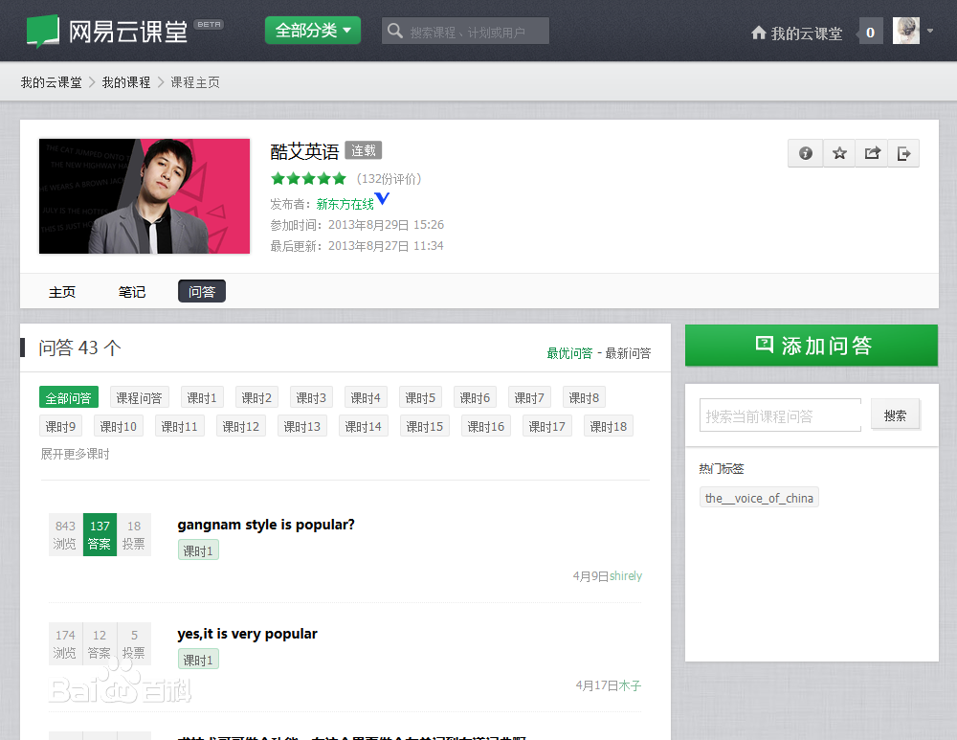
The key elements——How to learn
Questions and answers

Slide 13
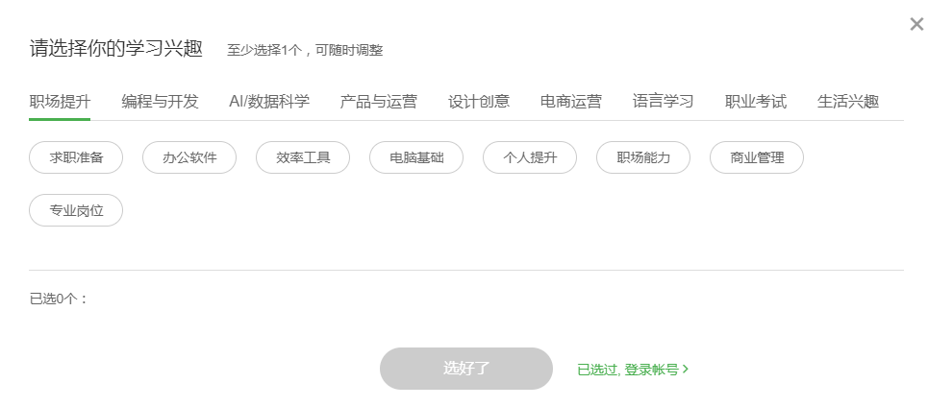
The key elements——The process of learning

Slide 14
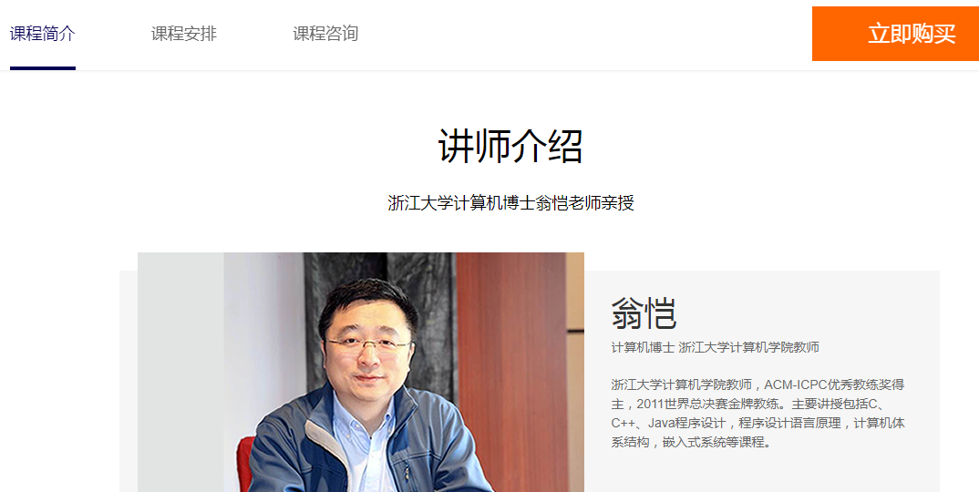
The key elements——The process of learning

Slide 15
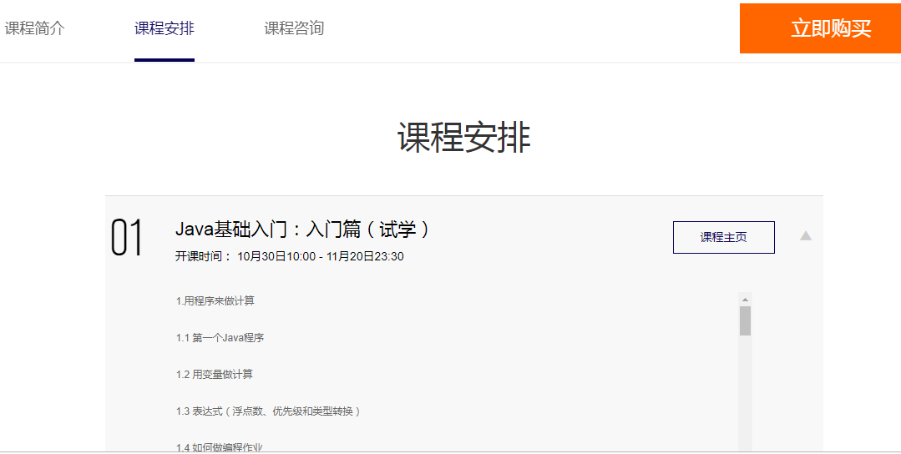
The key elements——The process of learning

Slide 16
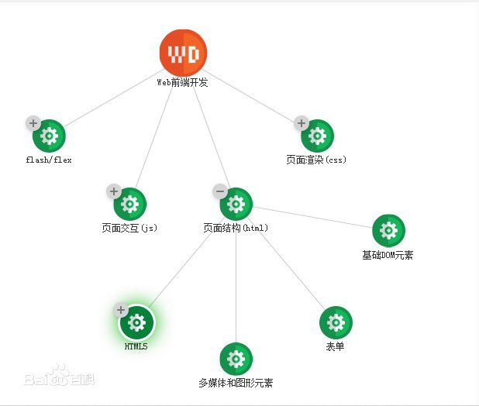
The key elements——The process of learning
The skill atlas

Slide 17
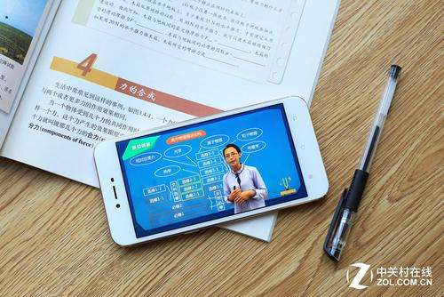
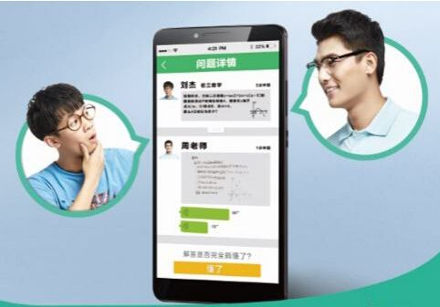

The key elements——From who to learn
The instructors
The learners
Ourselves

Slide 18
03
The summary

Slide 19
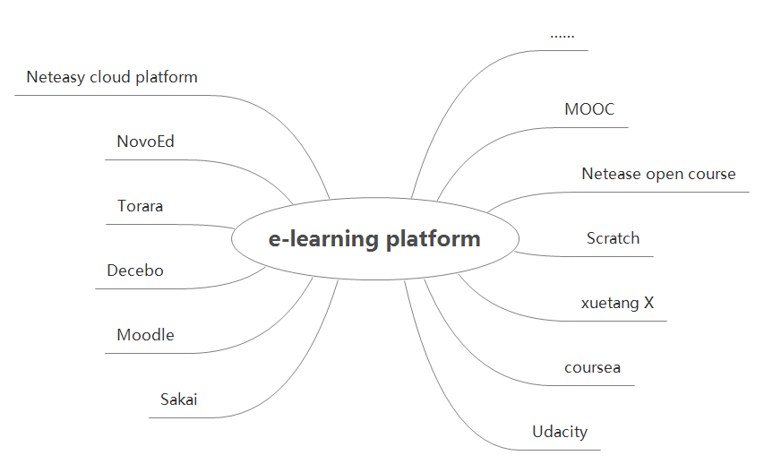
The summary

Slide 20
listening
Thanks for your
Group: The powerpuff girls
Member:Zhang Qinna,Yin Junhui,Shen Wangqi,
Zhou Chengmao,Liao Baige

